Slide 1

Housing Price Regression
Kevin Chen

Slide 2
Introduction
Goals
Predict housing prices
Identify which variables most strongly influence house prices
Compare models to find the most efficient and accurate model
Dataset
Contains 50,000 observations
Variables include Price, Square feet, Bathrooms, Bedrooms, YearBuilt, and Neighborhood
https://www.kaggle.com/datasets/muhammadbinimran/housing-price-prediction-data/data

Slide 3
Variables
Response variable
Price (dollars)
Predictor variables
SquareFeet - numeric
Bedrooms - numeric
Bathrooms - numeric
YearBuilt - numeric
Neighborhood - categorical (Urban/Suburban/Rural)

Slide 4
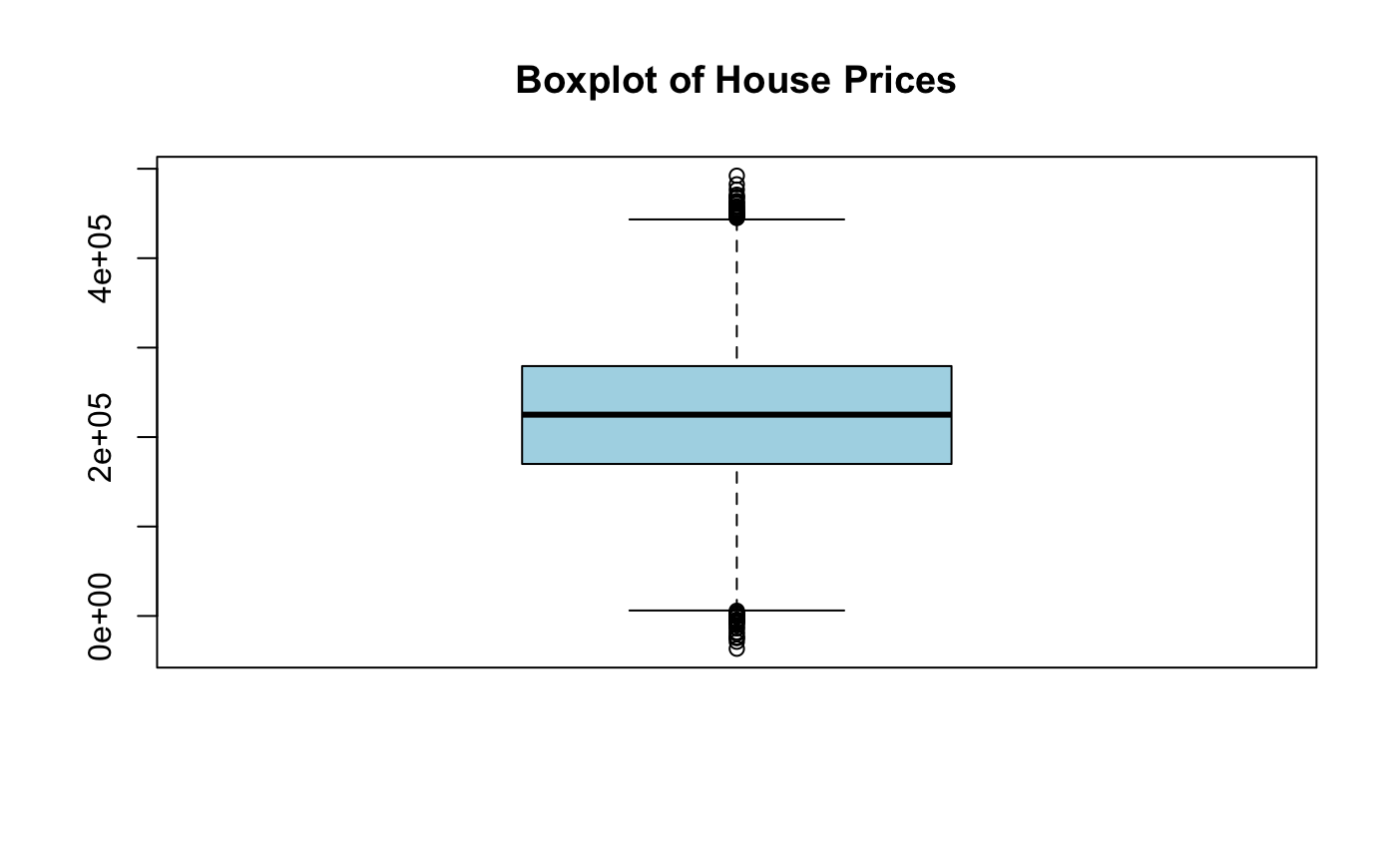
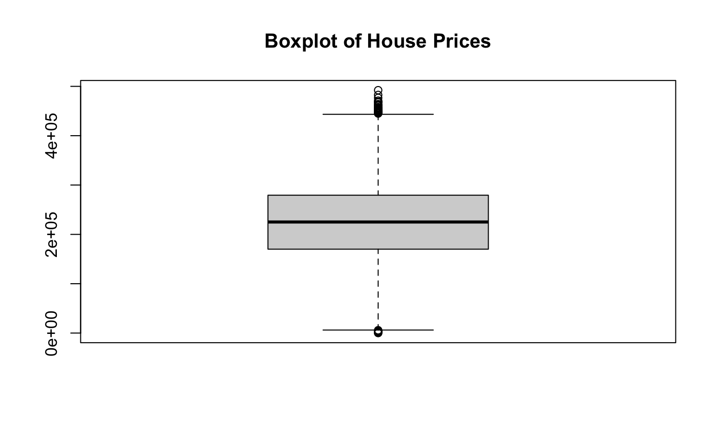
Data Cleaning
No missing values
Checked for outliers and removed unrealistic negative observations from the dataset
Higher priced homes were kept since they represent natural variations in the real estate market
Converted neighborhood to factor

Slide 5
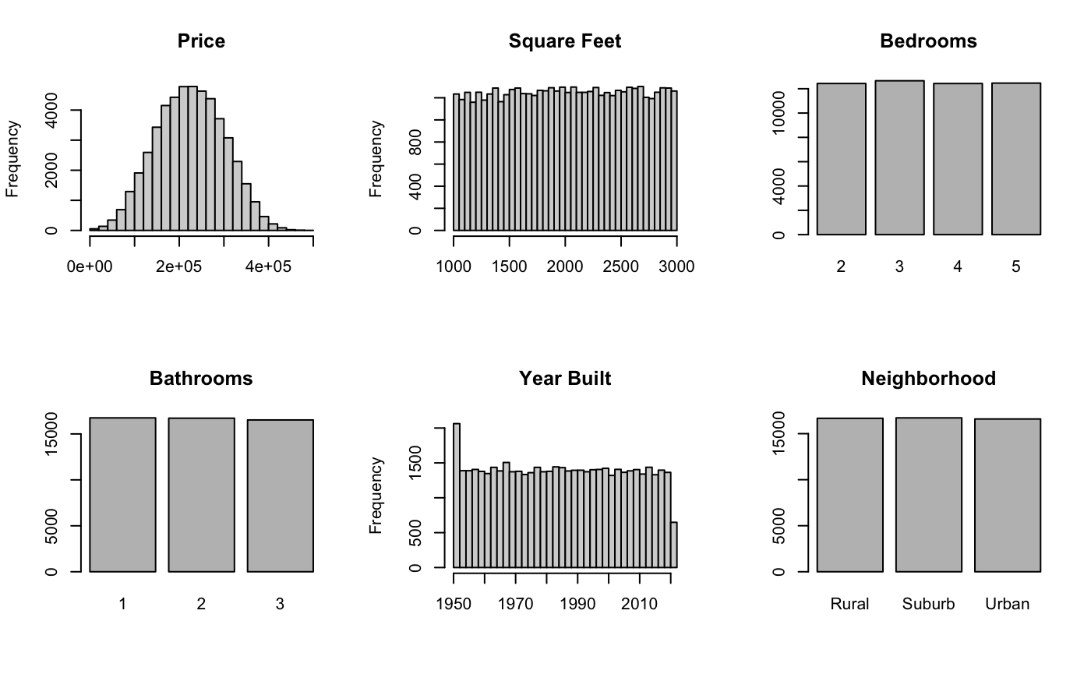
Exploratory Analysis
Price is roughly normally distributed
Square footage varies, which gives stronger predictive power
Bedrooms and bathrooms are balanced discrete counts
Neighborhood categories are evenly distributed
Year built spans many decades and are also evenly distributed

Slide 6
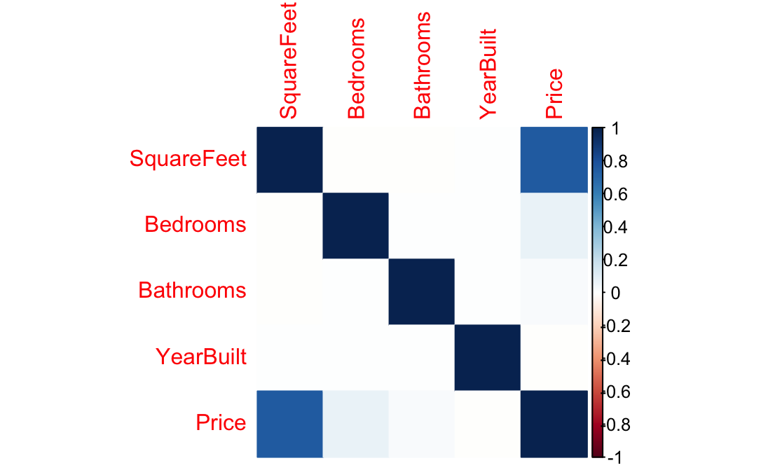
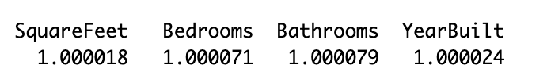
Correlation and Multicollinearity
Predictors show very low correlation
Square feet is the only predictor moderately related to price
All VIF values are approximately 1, confirming no collinearity
All the variables can be safely included in the model

Slide 7
Univariate Models
Predictor | p-value | R^2 | Estimate | Interpretation
Square Feet | <2.2e-16 | 0.5635 | +99.15 | Strong
Bedrooms | <2.2e-16 | 0.0053 | +4,964 | Strong
Bathrooms | <2.41e-10 | 0.00078 | +2,638.1 | Strong
Year Built | 0.61 | -1.477e-05 | -8.4 | Not significant
Neighborhood | 3.247e-6 | 0.00047 | +3,088.5 (urban) | Urban significant
Square footage explains the most variation in price (56% by itself)
Bedrooms and bathrooms are statistically significant but explain very little variation individually
Year built alone has no predictive value
Urban neighborhoods are slightly higher priced than rural in the univariate model

Slide 8
Full Multiple Regression Model
Predictor | Estimate | p-value | Interpretation
Square Feet | +99.168 | <2e-16 | significant positive
Bedrooms | +5,080.75 | <2e-16 | significant positive
Bathrooms | +2,826.1 | <2e-16 | significant positive
Year Built | -10.85 | 0.3133 | not significant
Neighborhood (urban vs rural) | +1,562.22 | 0.00425 | significant positive
Neighborhood (suburban vs rural) | -705.125 | 0.1961 | not significant
Multiple R-squared: 0.5702 Adjusted R-squared: 0.5701
The full model represents about 57% of the variations in house prices

Slide 9
Model Comparison
Model | Predictors | R-squared | Adjusted R-squared
Full Model | Sqft, Beds, Baths, YearBuilt, Neighborhood | 0.572 | 0.571
Reduced Model | Sqft, Beds, Baths, Neighborhood | 0.572 | 0.571
Did not remove neighborhood since urban is still significant
Removed YearBuilt since it was not significant in the full model
Since the results are the same with fewer predictors the reduced model is more efficient

Slide 10
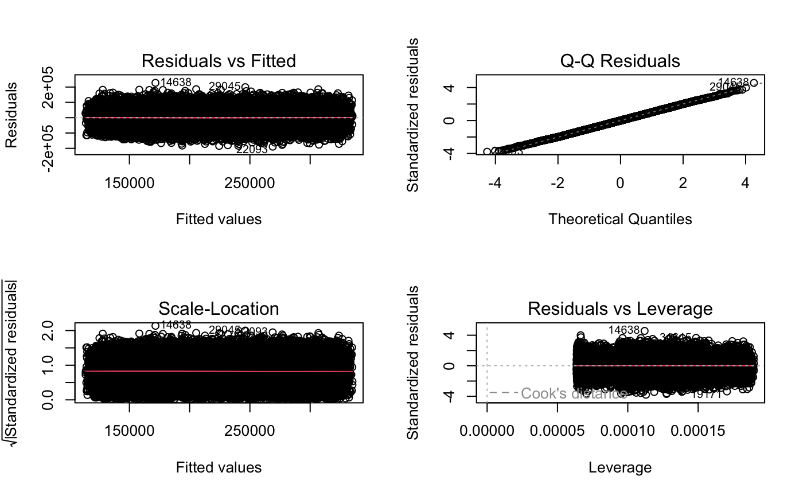
Model Diagnostics
Summary
Residuals vs Fitted: Points are randomly scattered around 0 with no curve or pattern noticeable -> no major nonlinearity
Q-Q Plot: points mostly follow the straight line -> residuals are approximately normal
Scale-Location Plot: Spread of points are fairly normal -> no major variance issues
Residuals vs Leverage: No points with high leverage -> no influential outliers
All regression assumptions are reasonably satisfied, so the final model is appropriate

Slide 11
Final Best Model
Price ~ SquareFeet + Bedrooms + Bathrooms + Neighborhood
Why?
Same R-squared as full model (~0.572)
More efficient since there are fewer predictors
All predictors are statistically significant
Diagnostics confirmed the model meets regression assumptions
This model explains ~57.2% of the variation in housing prices using only 4 meaningful predictors

Slide 12
Conclusion
Square footage:
Bigger homes = higher price (strongest predictor)
Bedrooms and Bathrooms:
More rooms or bathrooms = higher price (significant positive effects)
Neighborhood:
Urban homes = higher price
Year built:
Home age does not meaningfully affect price
Overall Model Performance:
Explains ~57% of price variation
Good for housing data, but remaining variation may reflect factors not included (lot size, renovations, school district, market conditions)

